Slide 1
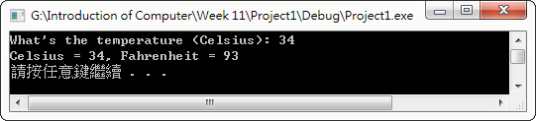
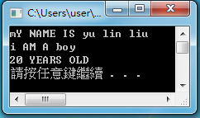
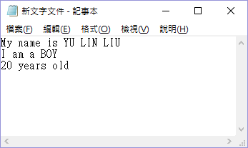
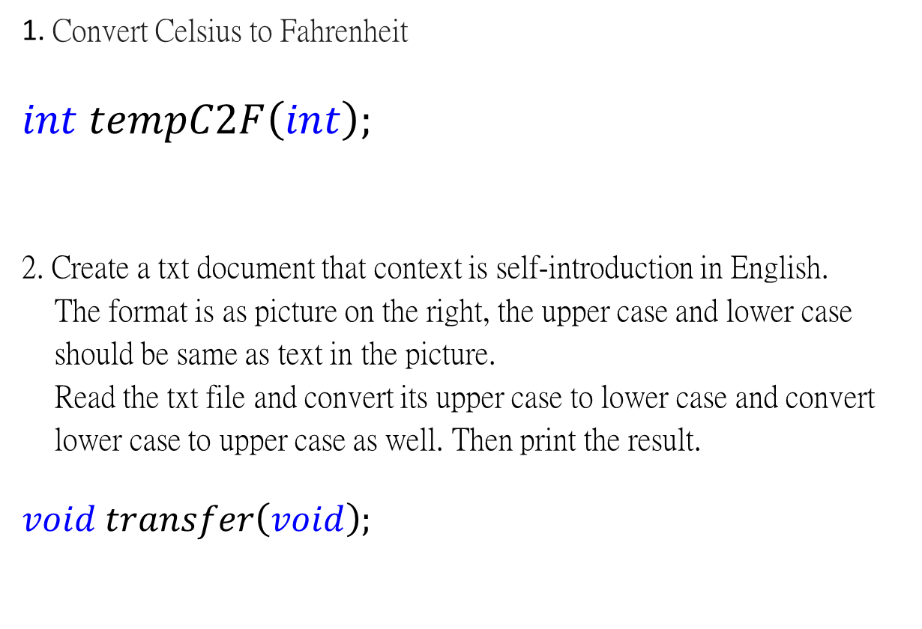

Homework (Function is needed for both of the homework.)
1. Convert Celsius to Fahrenheit
$$int tempC2F\left(int\right);$$
2. Create a txt document that context is self-introduction in English.
The format is as picture on the right, the upper case and lower case
should be same as text in the picture.
Read the txt file and convert its upper case to lower case and convert
lower case to upper case as well. Then print the result.
$$void transfer\left(void\right);$$
$$℉=\frac{9}{5}×℃+32$$
Name should be Romanization with upper case.
Gender use BOY/GIRL.
Age use Arabic numerals.

Slide 2
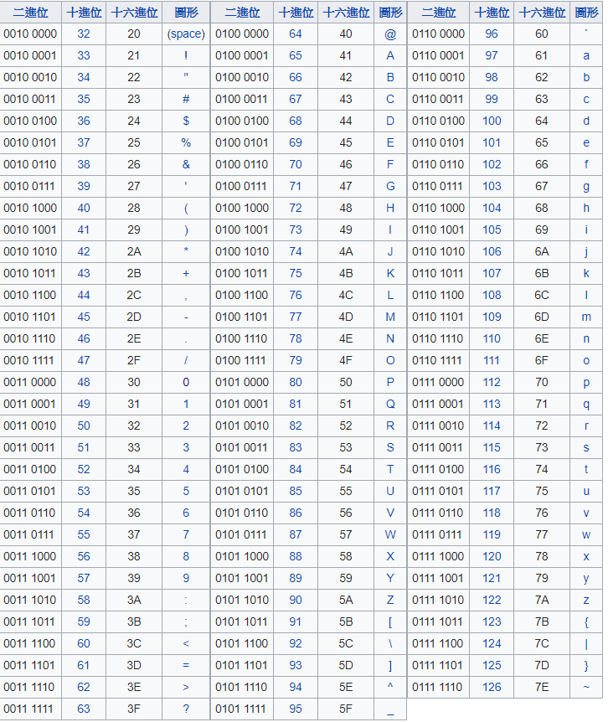
ASCII

